Slide 1

Azure End-to-End Lakehouse Data Engineering Pipeline
Cloud Based Data Analytics
Team 9

Slide 2
Our Team
Ashrith Rao
Shrot Pandey
Tejesh
Adhitya

Slide 3
Introduction
This project builds a complete Azure-based data engineering pipeline that ingests raw data using Azure Data Factory, stores it in Azure Data Lake, transforms it using Databricks and PySpark, and loads analytics-ready data into Azure Synapse Analytics for SQL querying and Power BI reporting. It follows the Medallion Architecture (Bronze, Silver, Gold) to ensure scalable, automated, and high-performance data processing.

Slide 4
Project Goals
Build a Scalable Cloud Data Pipeline: Design and implement an end-to-end data engineering workflow using Azure services.
Implement Medallion Architecture: Structure data into Bronze (raw), Silver (processed), and Gold (analytics-ready) layers.
Enable Big Data Processing: Use distributed computing with PySpark in Databricks for efficient transformation.
Deliver Business-Ready Analytics: Load curated data into Synapse for SQL querying and Power BI reporting.

Slide 5
Problems
1
2
Raw Data is Unstructured & Messy
APIs and datasets contain nulls, inconsistent schema, duplicates.
Manual Data Processing is Inefficient
Without automation, data ingestion & cleaning is slow.
3
4
Scalability Issues
Traditional systems cannot handle growing datasets efficiently.
Lack of Centralized
Analytics Layer Businesses struggle to generate fast insights from fragmented data.

Slide 6
Process
1
Data Ingestion – Bronze Layer
Create Azure resources
Configure Data Factory pipelines
Extract data from API/dataset
Store raw data in Data Lake Gen2
Maintain original format for traceability
Outcome: Raw data safely stored in cloud.

Slide 7
Process
2
Data Transformation – Silver Layer
Create Databricks workspace & cluster
Connect to Data Lake
Use PySpark for:
Data cleaning
Schema correction
Filtering & aggregation
Store processed data back in ADLS
Outcome: Clean, structured, optimized data.

Slide 8
Process
3
Data Warehousing & Analytics – Gold Layer
Create Synapse workspace
Use OPENROWSET() & External Tables
Load structured data
Perform analytical SQL queries
Integrate with Power BI
Outcome: Business-ready analytics dataset.

Slide 9
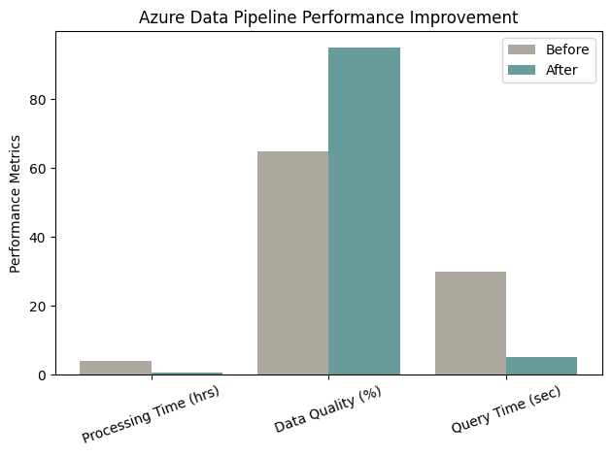
Result
Expected
Successfully built an End-to-End Azure Data Pipeline.
Automated ingestion and transformation process.
Implemented scalable Medallion Architecture.
Enabled SQL-based analytics and dashboard integration.
Demonstrated real-world data engineering workflow.

Slide 10
Conclusion
This project demonstrates how modern cloud technologies can transform raw, unstructured data into actionable insights using Azure’s ecosystem. By integrating Data Factory, Data Lake, Databricks, and Synapse, the system ensures scalability, automation, and high-performance analytics.
The solution reflects industry-standard data engineering practices and prepares the system for real-time processing, big data workloads, and enterprise-level reporting.

Slide 11
Thank You

